Slide 1
Catch the Deadline
Group Members:
Argert Boja
Bikem Çamli
Hareem Larik
Umut Ak
Group 2D

Slide 2
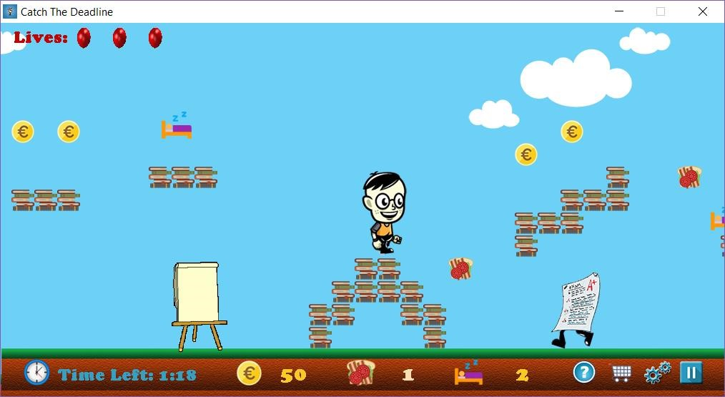
State of development
Until now, we have implemented almost every feature of the game. With respect to coverage of requirements and use cases, our game provides all the
functionalities that we have mentioned.
There will be several things that we will add in the project which are:
Adding more features to the enemies( e.g. shooting )
Add more sound effects

Slide 3
Identified problems/ Changes in Project
In second iteration, we did the necessary changes in our Analysis and Design Documentation according to the deficiencies we realize in the first iteration.
We change our subsystem decompositions according to the classes have been transferred to a new or a different package for modifiability.
Since the “.jar” file cannot easily interact with an embedded database, we decided to make the database online.

Slide 4
Changes in Implementation
We added some private attributes and functions which increased the interaction between classes.
Additionally, we added a store for the new weapons
Other than these, a few functions and attributes in a few classes, the implementation of our game was completely based on the subsystem design which was done in the second iteration design report.

Slide 5
Distribution of Work

Slide 6
Thank You for Listening!

